Slide 1

My Blogging Website: A Comprehensive Guide
This presentation will guide you through the exciting world of blogging, from developing your strategy to monetizing your content. Get ready to unlock the power of your voice and build a successful online platform!

Slide 2
Why Blogging? The Power of Content Creation
INTRODUCTION & DISCRIPTION
In today's digital age, content creation and sharing have become integral parts of our daily lives. Blogging serves as a powerful tool for individuals and organizations to express their thoughts, share knowledge, and engage with a global audience.
The AK-Blog project is a modern and dynamic blogging platform designed to cater to the needs of both individual bloggers and organizations. Utilizing a robust tech stack including Flask for the backend, SQL Alchemy for database management, and a combination of HTML, CSS, JavaScript, and Bootstrap for the frontend, this project ensures a seamless and engaging user experience.

Slide 3

Key Feature of this Project
User Registration and
Login
Content Creation and Editing Tools
1
2
Secure user authentication allows individuals to create accounts and log in to the platform.
Understand their interests, needs, and pain points. ensure a smooth user experience.
Dynamic Database
4
Responsive Design
3
The website adapts seamlessly across various devices, providing a consistent and accessible user experience
A structured SQLite database setup ensures smooth storage and retrieval of blog posts.

Slide 4

Technologies Used
FRONTEND
BACKEND
HTML & CSS, JavaScript, Bootstrap User Interface (UI): Provides an intuitive and responsive interface for users to interact with the platform.
Python (Flask), GitHub, Web Server: Handles HTTP requests, manages routing, and serves HTML templates and static files.
DATABASE
DEPLOYMENT
SQLITE, Database Schema: Structured to store user information, and metadata.
Render, Deployment Pipeline: Automates the deployment process, ensuring the latest code changes are reflected on the live website.

Slide 5





Developing Engaging Content
High-Quality Writing
Visual Appeal
Ensure your content is well-written, informative, and free of errors.
Use captivating images, videos, and graphics to enhance your posts.
Interactive Elements
Consistency
Encourage engagement through polls, quizzes, and comments sections.
Post regularly to maintain audience interest and build a loyal following.

Slide 6
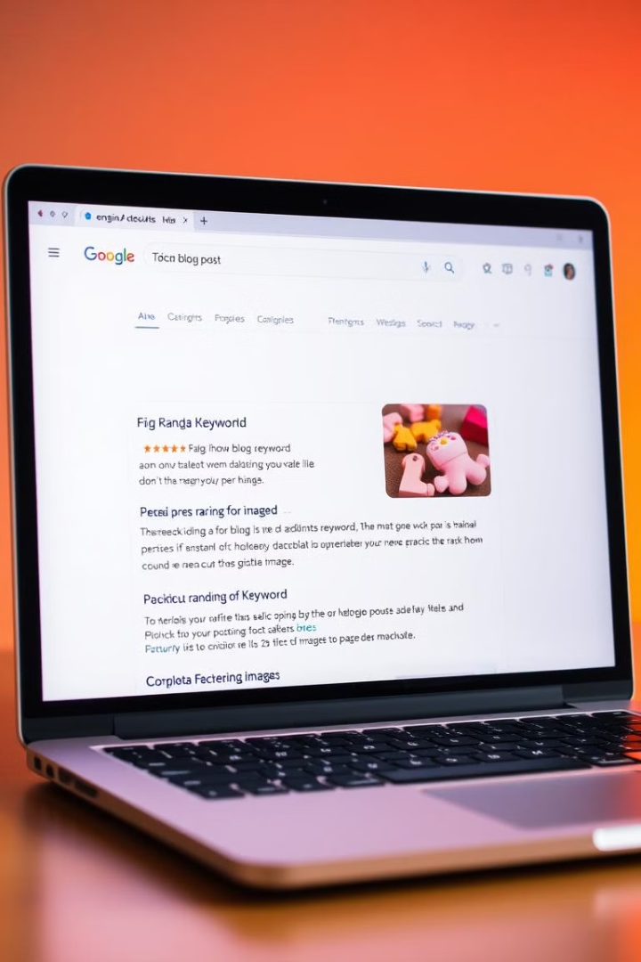
Search Engine Optimization (SEO) Essentials
1
Keyword Research
Identify relevant keywords that your target audience is searching for.
2
On-Page Optimization
Optimize your blog posts with relevant keywords in titles, headings, and content.
3
Off-Page Optimization
Build backlinks from other websites to increase your domain authority.

Slide 7


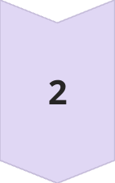

BENEFITS OF THIS PROJECT
User Engagement:
Readers can easily browse through various blog posts discover new topics, offering high-quality, curated content that keeps readers coming back for more.
Learning Opportunity:
Developing the project helps in learning and applying web development skills, including Flask, SQL Alchemy, and front-end technologies.
Responsive Design:
The website is fully responsive and can be easily viewed on any device, including desktops, tablets, and smartphones. This ensures a seamless and consistent user experience across different platforms.

Slide 8




Monetizing Your Blog: Generating Revenue
Affiliate Marketing
1
Promote products or services and earn a commission on sales.
Sponsored Posts
2
Partner with brands to create sponsored content.
Sell Digital Products
3
Create and sell ebooks, courses, or templates.
Display Advertising
4
Run ads on your blog and earn revenue based on clicks or impressions.

Slide 9
Analytics and Measuring Success
Google Analytics
1
Track our website traffic, audience demographics, and engagement.
GITHUB ACC
2
https://github.com/Ashwin-1718
DEPLOYMENT ON RENDER
3
https://ak-blog-dxkk.onrender.com

Slide 10

The Future of Your Blogging Journey
1
2
Stay Updated
Experiment
Keep learning about new trends and best practices in blogging.
Try different strategies and find what works best for you.
3
4
Build Relationships
Stay Passionate
Connect with other bloggers and industry experts.
Keep creating content that you love and that resonates with your audience.

